Slide 1

Web Technologies Basics
HTTP, HTML, Text, Images, Tables, Forms, CSS
Svetlin Nakov
Telerik Corporation
www.telerik.com

Slide 2
Table of Contents
WWW and the HTTP protocol
Request-response model
GET vs. POST
HTML Basics
Text, Images, Tables, Forms
CSS
Styling Web content with CSS

Slide 3
WWW and HTTP
HTTP Protocol: the Driving Engine of the WWW

Slide 4
What is WWW?
WWW = World Wide Web = Web
Global distributed information space in Internet
A service in Internet (like E-mail, DNS, ...)
A set of documents (and other resources) located on different Internet servers
Accessed through standard protocols like HTTP, HTTPS and FTP by their URL
Web servers provide Web content
Web browsers display the Web content

Slide 5
WWW Components
Structural components
Internet – provides data transfer based on TCP and HTTP protocols
Clients (Web browsers) – display Web content
Web servers – Apache, IIS, Tomcat, etc.
Semantic components
Hyper Text Transfer Protocol (HTTP)
Hyper Text Markup Language (HTML)
Uniform Resource Locator (URL)
Uniform Resource Identifiers (URIs)

Slide 6
WWW Infrastructure
Clients use Web browser application to request resources from the Web servers via HTTP
Resources have unique URL address
Servers send the requested resource as a response
Or reply with an error message
Web pages are resources in WWW
HTML text, graphics, animations and other files
Web sites
Web sites are sets of Web pages in WWW

Slide 7
WWW Infrastructure (2)
Client’s browser renders Web pages returned by the Web servers
Pages are in HTML (Hyper Text Markup Language)
Browsers shows the text, graphics and sounds
HTML pages contain hyperlinks to other pages
The entire WWW system runs over standard networking protocols
TCP/IP, DNS, HTTP, …
HTTP protocol is fundamental for WWW

Slide 8
Main Components of WWW: URL
Uniform Resource Locator (URL)
Unique resource location in WWW, e.g.
It is just a formatted string
Protocol for communicating with server (e.g., http, ftp, https, ...)
Name of the server or IP address (e.g., www.telerik.com)
Path and name of the resource (e.g., index.php)
Parameters (optional, e.g. ?id=27&lang=en)
http://www.telerik.com/academy/winter-2009-2010.aspx

Slide 9
URL Encoding
URLs are encoded according RFC 1738:
All other characters are escaped with the formula:
Example: space has decimal code 32, in hex – 20, so space in URL becomes %20
Space can also be encoded as "+"
“... Only alphanumeric [0-9a-zA-Z], the special characters $-_.+!*'() and reserved characters used for their reserved purposes may be used unencoded within an URL.”
%[hex code of character in ISO-Latin character set]

Slide 10
Main Components of WWW: HTML
Hyper Text Markup Language (HTML)
Formatted text with images and hyperlinks
Interpreted and displayed by Web browsers
A web (HTML) page consists of:
HTML file
CSS styles file
Set of images
Other resources

Slide 11
Main Components of WWW: HTML
HTML is straight-forward and easy to learn
Simplest HTML documents are plain text files
Easy to add formatting, references, bullets, etc.
Images can be added as separate files
Can be automatically generated by authoring programs
Tools to aid users in creating HTML files
E.g. FrontPage, Dreamweaver, Visual Studio

Slide 12
HTML – Example
<html>
<head><title>HTML Example</title></head>
<body>
<h1>Heading 1</h1>
<h2>Sub heading 2</h2>
<h3>Sub heading 3</h3>
<p>This is my first paragraph</p>
<p>This is my second paragraph</p>
<div align="center"
style="background:skyblue">
This is a div</div>
</body>
</html>

Slide 13
Main Components of WWW: HTTP
Hyper Text Transfer Protocol (HTTP)
Client-server protocol for transferring Web resources
Important properties of HTTP
Request-response protocol
Reliance on a global URL
Resource metadata
Stateless
Text format

Slide 14
The HTTP Protocol
How HTTP Works?

Slide 15
HTTP: Request-Response Protocol
Client program
Running on end host
Requests service
E.g., Web browser
Server program
Running on end host
Provides service
E.g., Web server
GET /index.html
"Welcome to out
Web site!"
15

Slide 16
Example: Hyper Text Transfer Protocol
HTTP request
GET /courses/archive/spring06/cos461/ HTTP/1.1
Host: www.cs.princeton.edu
User-Agent: Mozilla/4.03
<CRLF>
The empty line denotes the end of the request header
HTTP response
HTTP/1.1 200 OK
Date: Mon, 6 Feb 2006 13:09:03 GMT
Server: Netscape-Enterprise/3.5.1
Last-Modified: Mon, 6 Feb 2006 11:12:23 GMT+2
Content-Length: 54
<CRLF>
<html><title>Hello</title>
Welcome to our site</html>
The empty line denotes the end of the response header

Slide 17
HTTP Request Message
Request message sent by a client consists of
Request line – request method (GET, POST, HEAD, ...), resource URI, and protocol version
Request headers – additional parameters
Body – optional data
E.g. posted form data, files, etc.
<request method> <resource> HTTP/<version>
<headers>
<empty line>
<body>

Slide 18
HTTP GET Request – Example
Example of HTTP GET request:
GET /academy/winter-2009-2010.aspx HTTP/1.1
Host: www.telerik.com
Accept: */*
Accept-Language: bg
Accept-Encoding: gzip, deflate
User-Agent: Mozilla/4.0(compatible;MSIE 6.0; Windows NT 5.0)
Connection: Keep-Alive
Cache-Control: no-cache
<CRLF>

Slide 19
HTTP POST Request – Example
Example of HTTP POST request:
POST /webmail/login.phtml HTTP/1.1
Host: www.abv.bg
Accept: */*
Accept-Language: bg
Accept-Encoding: gzip, deflate
User-Agent: Mozilla/4.0(compatible;MSIE 6.0; Windows NT 5.0)
Connection: Keep-Alive
Cache-Control: no-cache
Content-Length: 59
<CRLF>
LOGIN_USER=mente
DOMAIN_NAME=abv.bg
LOGIN_PASS=taina-maina
<CRLF>

Slide 20
Conditional HTTP GET – Example
Example of HTTP conditional GET request:
GET /academy/join.aspx HTTP/1.1
Host: www.telerik.com
User-Agent: Gecko/20100115 Firefox/3.6
If-Modified-Since: Tue, 9 Mar 2010 11:12:23 GMT
<CRLF>
Fetches the resource only if it has been changed at the server
Server avoids wasting resources to send again
Returns “304 Not Modified” if the resource has not been changed
Or “200 OK” with the latest version otherwise

Slide 21
HTTP Response Message
Response message sent by the server
Status line – protocol version, status code, status phrase
Response headers – provide some meta data
Body – the contents of the response (the requested resource)
HTTP/<version> <status code> <status text>
<headers>
<CRLF>
<response body – the requested resource>

Slide 22
HTTP Response – Example
Example of HTTP response from the Web server:
HTTP/1.1 200 OK
Date: Fri, 17 Jul 2010 16:09:18 GMT+2
Server: Apache/2.2.14 (Linux)
Accept-Ranges: bytes
Content-Length: 73
Content-Type: text/html
<html>
<head> <title> Test </title> </head>
Test HTML page.
</html>

Slide 23
HTTP Response – Example
Example of HTTP response with error result:
HTTP/1.1 404 Not Found
Date: Fri, 17 Jul 2010 16:09:18 GMT+2
Server: Apache/2.2.14 (Linux)
Connection: close
Content-Type: text/html
<HTML><HEAD>
<TITLE>404 Not Found</TITLE>
</HEAD><BODY>
<H1>Not Found</H1>
The requested URL /img/telerik-logo.gif was not found on this server.<P>
<HR><ADDRESS>Apache/2.2.14 Server at Port 80</ADDRESS>
</BODY></HTML>

Slide 24
HTTP Request Methods
HTTP request methods include
GET
Return current value of resource, run a program at the server, …
HEAD
Return the meta-data associated with a resource (headers only)
POST
Update a resource, provide input data to a program at the server, …

Slide 25
HTTP Response Codes
HTTP response code classes
1xx: informational (e.g., “100 Continue”)
2xx: success (e.g., “200 OK”)
3xx: redirection (e.g., “304 Not Modified”, "302 Found")
4xx: client error (e.g., “404 Not Found”)
5xx: server error (e.g., “503 Service Unavailable”)
"302 Found" is used for redirecting the Web browser to another URL

Slide 26
Cookies
Cookie
Small state stored by the client on behalf of the server
Included in future HTTP requests to the server
Request
Response
Set-Cookie: XYZ
Next request
Cookie: XYZ

Slide 27


HTTP Developer Tools
Wireshark packet analyzer (sniffer)
Intercepts the IP network traffic
Can reconstruct the HTTP conversation
Free, open-source project – www.wireshark.org
Firebug plug-in for Firefox
The ultimate tool for monitoring, editing and debugging HTTP, HTML, CSS, JavaScript, etc.
Free, open-source – www.getfirebug.com

Slide 28
HTML Basics
Text, Images, Tables, Forms

Slide 29
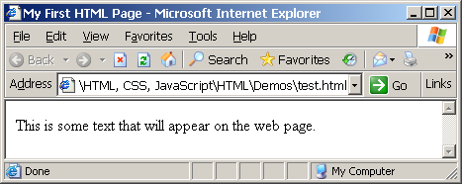
First HTML Page
test.html
<html>
<head>
<title>My First HTML Page</title>
</head>
<body>
This is some text that will
appear on the web page.
</body>
</html>

Slide 30
First HTML Page: Tags
Opening tag
<html>
<head>
<title>My First HTML Page</title>
</head>
<body>
This is some text that will
appear on the web page.
</body>
</html>
Closing tag

Slide 31
First HTML Page: Header
HTML header
<html>
<head>
<title>My First HTML Page</title>
</head>
<body>
This is some text that will
appear on the web page.
</body>
</html>

Slide 32
First HTML Page: Body
<html>
<head>
<title>My First HTML Page</title>
</head>
<body>
This is some text that will
appear on the web page.
</body>
</html>
HTML body

Slide 33
Some Simple Tags
Hyperlink Tags
Image Tags
Formatting tags
<a href="http://www.telerik.com.org/"
title="Telerik">Link to Telerik Web site</a>
<img src="logo.gif" alt="logo" />
<b>This text is bold</b>
And this is <u>underlined</u>
<center>Some centered text</center>

Slide 34
Some Simple Tags – Example
some-tags.html
<html>
<body>
<a href="http://www.devbg.org/" title=
"BASD">This is a link to some URL</a>
<br />
<img src="logo.gif" alt="logo" />
<br />
<b>This text is bold</b>
<br />
And this is <u>underlined</u>
<br />
<center>Some centered text</center>
</body>
</html>

Slide 35
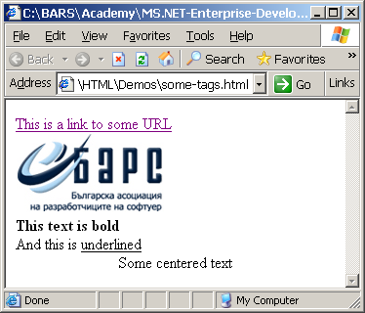
Some Simple Tags – Example (2)
some-tags.html
<html>
<body>
<a href="http://www.devbg.org/" title=
"BASD">This is a link to some URL</a>
<br />
<img src="logo.gif" alt="logo" />
<br />
<b>This text is bold</b>
<br />
And this is <u>underlined</u>
<br />
<center>Some centered text</center>
</body>
</html>

Slide 36
Tags Attributes
Tags have attributes
Attributes specify their properties and behavior
Example:
Few attributes that apply to every element: id, style, class, title
The id is unique in the document
Content of title attribute is displayed as hint when element is hovered with mouse
Some elements have obligatory attributes
Attribute alt with value "logo"
<img src="logo.gif" alt="logo" />

Slide 37
Headings and Paragraphs
Heading Tags
Paragraph Tags
Sections: div and span
<h1>Heading 1</h1>
<h2>Sub heading 2</h2>
<h3>Sub heading 3</h3>
<p>This is my first paragraph</p>
<p>This is my second paragraph</p>
<div align="center" style=
"background: skyblue">This is a div</div>

Slide 38
Headings and Paragraphs – Example
headings.html
<html>
<head><title>Headings and
paragraphs</title></head>
<body>
<h1>Heading 1</h1>
<h2>Sub heading 2</h2>
<h3>Sub heading 3</h3>
<p>This is my first paragraph</p>
<p>This is my second paragraph</p>
<div align="center"
style="background:skyblue">
This is a div</div>
</body>
</html>

Slide 39
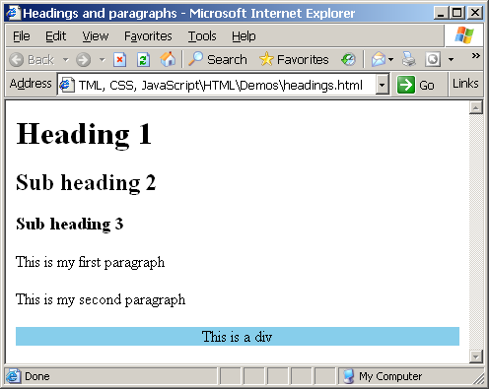
Headings and Paragraphs – Example (2)
headings.html
<html>
<head><title>Headings and
paragraphs</title></head>
<body>
<h1>Heading 1</h1>
<h2>Sub heading 2</h2>
<h3>Sub heading 3</h3>
<p>This is my first paragraph</p>
<p>This is my second paragraph</p>
<div align="center"
style="background:skyblue">
This is a div</div>
</body>
</html>

Slide 40
The <!doctype> Declaration
Beginning of HTML document must have a document type declaration
It tells Web browsers how to handle the version of HTML you are writing
Possible versions: HTML 2.0, HTML 3.2, HTML 4.01, XHTML 1.0, XHTML 1.1, …
Example:
See http://www.w3.org/QA/2002/04/Web-Quality for a list of possible doctypes
<!DOCTYPE html PUBLIC "-//W3C//DTD XHTML 1.0 Transitional//EN" "http://www.w3.org/TR/xhtml1/DTD/xhtml1-transitional.dtd">

Slide 41
HTML vs. XHTML
XHTML is more strict
All tags must be properly nested (HTML allows <b><i>text</b></i>)
All tags and attribute names must be written in lower case, attribute values must be in " " (HTML allows ' ')
All tags must be closed (<br/>, <img/>) while HTML allows <br> and <img>
XHTML allows only one root <html> element (HTML allows more than one)

Slide 42
XHTML vs. HTML (2)
Many element attributes are deprecated in XHTML, most are moved to CSS
Attribute minimization is forbidden, e.g.
Browsers load XHTML faster than HTML and valid code faster than invalid
<input type="checkbox" checked>
<input type="checkbox" checked="checked" />

Slide 43
HTML Structure
HTML is comprised of elements called “tags”
Begins with <html> and ends with </html>
When writing XHTML, must define a namespace
Tags are nested one inside another:
Tags have attributes:
HTML describes structure using two main sections: <head> and <body>
<html xmlns="http://www.w3.org/1999/xhtml">
<html> <head></head> <body></body> </html>
<img src="logo.jpg" alt="logo" />

Slide 44
The <head> Section
Contains information that doesn’t show directly on the viewable page
Starts after the <!doctype> declaration
Begins with <head> and ends with </head>
Contains mandatory single <title> tag
Can contain multiple nested tags, e. g.:
<meta>
<script>
<style>
<!– comments -->

Slide 45
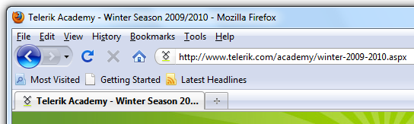
<head> Section: <title> tag
Title should be placed between <head> and </head> tags
Use to give a title to the Web page window
Search engines and people rely on titles
<title>Telerik Academy – Winter Season 2009/2010</title>

Slide 46
<head> Section: <meta>
Meta tags additionally describe the content contained within the page
<meta name="description" content="HTML tutorial">
<meta name="keywords" content="html, web design, styles">
<meta name="author" content="Chris Brewer">
<meta http-equiv="refresh" content="5; url=http://www.telerik.com">

Slide 47
<head> Section: <script>
The <script> </script> tag is used to embed scripts into an HTML document
Script are executed in the client's Web browser
Supported client-side scripting languages:
JavaScript (it is not Java!)
VBScript
JScript

Slide 48
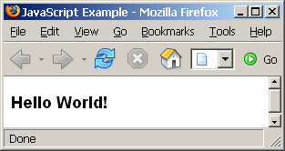
The <script> Tag – Example
scripts-example.html
<html>
<head>
<title>JavaScript Example</title>
<script type="text/javascript">
function sayHello() {
document.write(
"<p><b>Hello World!<\/b>");
}
</script>
</head>
<body>
<script type=
"text/javascript">
sayHello();
</script>
</body>
</html>

Slide 49
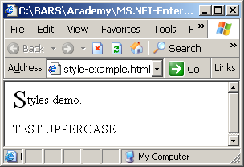
<head> Section: <style>
The <style> </style> tag embeds formatting information (CSS styles) into a HTML page
style-example.html
<html>
<head>
<style type="text/css">
p { font-size: 12pt; line-height: 12pt }
p:first-letter { font-size: 200%; float: left }
span { text-transform: uppercase }
</style>
</head>
<body>
<p>Styles demo.</p>
<span>Test uppercase</span>.
</body>
</html>

Slide 50
Comments: <!-- --> Tag
Comments can exist anywhere between the <html></html> tags
Comments start with <!-- and end with -->
<!–- BASD Logo (it is a GIF file with transparent background) -->
<img src="logo.gif" alt="BASD Logo">
<!–- Hyperlink to BASD official Web site -->
<a href="http://www.devbg.org/">BASD Home</a>
<!–- Show the news table -->
<table class="newstable">
...

Slide 51
<body> Section: Introduction
The <body> section describes the viewable portion of the page
Starts after the <head> </head> section
Begins with <body> and ends with </body>
<html>
<head><title>Test page</title></head>
<body>
This is the Web page body!
</body>
</html>

Slide 52
<body> Section: Attributes
The <body> tag has the following attributes:
Example:
background | Background image file | ="URL"
bgcolor | Background color | ="color"
text | Default text color | ="color"
link | Hyperlink color | ="color"
vlink | Visited hyperlink color | ="color"
<body background="texture.gif" text="#238E23">
* For color codes, see www.webreference.com/html/tools/colorizer/

Slide 53
Text Styling without CSS
Text can be formatted as headings or regular paragraph text
Use these consistently!
<p></p> by default doubles the spaces after each paragraph
<br /> is weird: the trailing “/” makes it XHTML compliant
Different styles of heading are available:
<h1></h1> | Heading 1
<h2></h2> | Heading 2
<h3></h3> | Heading 3
<h4></h4> | Heading 4
<h5></h5> | Heading 5
<h6></h6> | Heading 6
<p></p> | Paragraph
<br /> | Line break

Slide 54
Text Formatting
Text formatting tags modify the text between the opening tag and the closing tag
Ex. <b>Hello</b> makes “Hello” bold
<b></b> | bold
<i></i> | italicized
<u></u> | underlined
<sup></sup> | Sample^{superscript}
<sub></sub> | Sample_{subscript}
<strong></strong> | strong
<em></em> | emphasized
<pre></pre> | Preformatted text
<blockquote></blockquote> | Quoted text block
<del></del> | Deleted text – strike through

Slide 55
Text Formatting – Example
text-formatting.html
<!DOCTYPE html PUBLIC
"-//W3C//DTD XHTML 1.0 Transitional//EN"
"http://www.w3.org/TR/xhtml1/DTD/xhtml1-transitional.dtd">
<html>
<head>
<title>Svetlin Nakov</title>
</head>
<body bgcolor="black" text="white" link="red" vlink="blue">
<h1>Notice</h1>
<p>This is a <em>sample</em> Web page.</p>
<p><pre>Next paragraph:
preformatted.</pre></p>
<h2>More Info</h2>
<p>Specifically, we’re using XHMTL 1.0 transitional.<br>
Next line.</p>
</body>
</html>

Slide 56
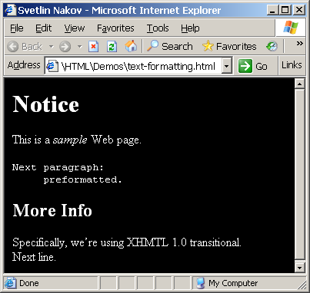
Text Formatting – Example (2)
text-formatting.html
<!DOCTYPE html PUBLIC
"-//W3C//DTD XHTML 1.0 Transitional//EN"
"http://www.w3.org/TR/xhtml1/DTD/xhtml1-transitional.dtd">
<html>
<head>
<title>Svetlin Nakov</title>
</head>
<body bgcolor="black" text="white" link="red" vlink="blue">
<h1>Notice</h1>
<p>This is a <em>sample</em> Web page.</p>
<p><pre>Next paragraph:
preformatted.</pre></p>
<h2>More Info</h2>
<p>Specifically, we’re using XHMTL 1.0 transitional.<br>
Next line.</p>
</body>
</html>

Slide 57
Hyperlinks: <a> Tag
Link to a document called form.html on the same server in the same directory:
Link to a document called parent.html on the same server in the parent directory:
Link to a document called cat.html on the same server in the subdirectory stuff:
<a href="form.html">Fill Our Form</a>
<a href="../parent.html">Parent</a>
<a href="stuff/cat.html">Catalog</a>

Slide 58
Hyperlinks: <a> Tag (2)
Link to an external Web site:
Always use a full URL, including "http://", not just "www.somesite.com"
Using the target="_blank" attribute opens the link in a new window
Link to an e-mail address:
<a href="http://www.devbg.org" target="_blank">BASD</a>
<a href="mailto:bugs@example.com?subject=Bug+Report">
Please report bugs here (by e-mail only)</a>

Slide 59
Hyperlinks: <a> Tag (3)
Link to a document called apply-now.html
On the same server, in same directory
Using an image as a link button:
Link to a document called index.html
On the same server
In the subdirectory english of the parent directory:
<a href="apply-now.html"><img
src="apply-now-button.jpg" /></a>
<a href="../english/index.html">Switch to English version</a>

Slide 60
Hyperlinks and Sections
Link to another location in the same document:
Link to a specific location in another document:
<a href="#section1">Go to Introduction</a>
...
<a name="section1">Introduction</a>
<a href="chapter3.html#section3.1.1">Go to Section 3.1.1</a>
<!–- In chapter3.html -->
...
<a name="section3.1.1">
<h3>3.1.1. Technical Background</h3>
</a>

Slide 61
Hyperlinks – Example
hyperlinks.html
<a href="form.html">Fill Our Form</a> <br/>
<a href="../parent.html">Parent</a> <br/>
<a href="stuff/cat.html">Catalog</a> <br/>
<a href="http://www.devbg.org" target="_blank">BASD</a> <br/>
<a href="mailto:bugs@example.com?subject=Bug Report">Please report bugs here (by e-mail only)</a> <br/>
<a href="apply-now.html"><img src="apply-now-button.jpg" border="0"/></a> <br/>
<a href="../english/index.html">Switch to English version</a> <br/>

Slide 62
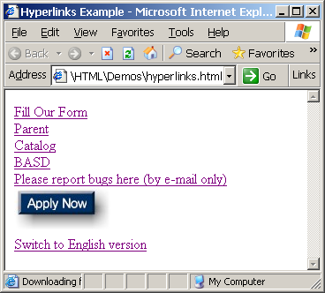
Hyperlinks – Example (2)
hyperlinks.html
<a href="form.html">Fill Our Form</a> <br/>
<a href="../parent.html">Parent</a> <br/>
<a href="stuff/cat.html">Catalog</a> <br/>
<a href="http://www.devbg.org" target="_blank">BASD</a> <br/>
<a href="mailto:bugs@example.com?subject=Bug Report">Please report bugs here (by e-mail only)</a> <br/>
<a href="apply-now.html"><img src="apply-now-button.jpg" border="0"/></a> <br/>
<a href="../english/index.html">Switch to English version</a> <br/>

Slide 63
Links to the Same Document – Example
links-to-same-document.html
<h1>Table of Contents</h1>
<p><a href="#section1">Introduction</a><br/>
<a href="#section2">Some background</A><br/>
<a href="#section2.1">Project History</a><br/>
...the rest of the table of contents...
<!-- The document text follows here -->
<h2><a name="section1">Introduction</a></h2>
... Section 1 follows here ...
<h2><a name="section2">Some background</a></h2>
... Section 2 follows here ...
<h3><a name="section2.1">Project History</a></h3>
... Section 2.1 follows here ...

Slide 64
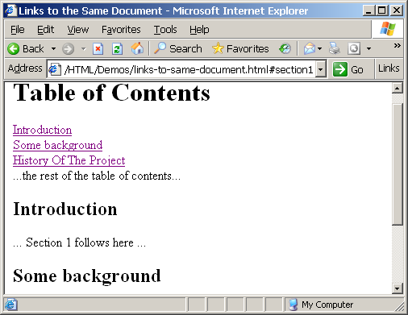
Links to the Same Document – Example (2)
links-to-same-document.html
<h1>Table of Contents</h1>
<p><a href="#section1">Introduction</a><br/>
<a href="#section2">Some background</A><br/>
<a href="#section2.1">Project History</a><br/>
...the rest of the table of contents...
<!-- The document text follows here -->
<h2><a name="section1">Introduction</a></h2>
... Section 1 follows here ...
<h2><a name="section2">Some background</a></h2>
... Section 2 follows here ...
<h3><a name="section2.1">Project History</a></h3>
... Section 2.1 follows here ...

Slide 65
Images: <img> tag
Add an image:
There are a number of attributes:
Example:
<img src="/img/basd-logo.png">
src | Location of image file (relative or absolute)
alt | Substitute text for display (e.g. in text mode)
align | Text alignment: bottom, middle, top
height | Number of pixels of the height
width | Number of pixels of the width
border | Size of border, 0 for no border
<img src="./php-logo.png" alt="PHP logo" border="0">

Slide 66
Miscellaneous Tags
<hr />: Draws a horizontal rule (line):
<center></center>: Deprecated!
<font>: Changes font style
With CSS, there is no reason to use this tag
<hr size="5" width="70%" />
<center>Hello World!</center>
<font size="3" color="blue">Font3</font>
<font size="+4" color="blue">Font+4</font>

Slide 67
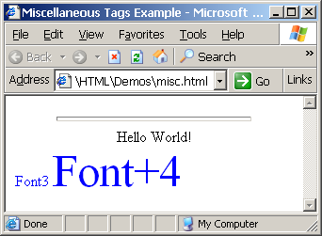
Miscellaneous Tags – Example
misc.html
<html>
<head>
<title>Miscellaneous Tags Example</title>
</head>
<body>
<hr size="5" width="70%" />
<center>Hello World!</center>
<font size="3" color="blue">Font3</font>
<font size="+4" color="blue">Font+4</font>
</body>
</html>

Slide 68
Ordered Lists: <ol> Tag
Create an Ordered List using <ol></ol>:
Attribute values for type are 1, A, a, I, or i
<ol type="1">
<li>Apple</li>
<li>Orange</li>
<li>Grapefruit</li>
</ol>
Apple
Orange
Grapefruit
Apple
Orange
Grapefruit
Apple
Orange
Grapefruit
Apple
Orange
Grapefruit
Apple
Orange
Grapefruit

Slide 69
Unordered Lists: <ul> Tag
Create an Unordered List using <ul></ul>:
Attribute values for type are:
disc, circle or square
<ul type="disk">
<li>Apple</li>
<li>Orange</li>
<li>Grapefruit</li>
</ul>
Apple
Orange
Pear
Apple
Orange
Pear
Apple
Orange
Pear

Slide 70
Definition lists: <dl> tag
Create definition lists using <dl>
Pairs of text and associated definition; text is in <dt> tag, definition in <dd> tag
Renders without bullets
Definition is indented
<dl>
<dt>HTML</dt>
<dd>A markup language …</dd>
<dt>CSS</dt>
<dd>Language used to …</dd>
</dl>

Slide 71
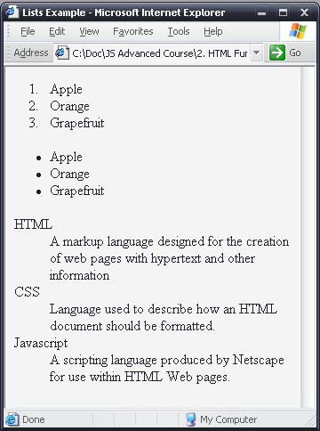
Lists – Example
lists.html
<html>
<body>
<ol type="1">
<li>Apple</li>
<li>Orange</li>
<li>Grapefruit</li>
</ol>
<ul type="disc">
<li>Apple</li>
<li>Orange</li>
<li>Grapefruit</li>
</ul>
<dl>
<dt>HTML</dt>
<dd>A markup lang…</dd>
</dl>
</body>
</html>

Slide 72
HTML Special Characters
Symbol Name
HTML Entity
Symbol
Copyright Sign
&copy;
©
Registered Trademark Sign
&reg;
®
Trademark Sign
&trade;
™
Less Than
&lt;
<
Greater Than
&gt;
>
Ampersand
&amp;
&
Non-breaking Space
&nbsp;
Em Dash
&mdash;
—
Quotation Mark
&quot;
"
Euro
&#8364;
€
British Pound
&pound;
£
Japanese Yen
&yen;
¥

Slide 73
Special Chars – Example
special-chars.html
<html>
<head>
<title>Special HTML Characters Example</title>
</head>
<body>
<p>[&gt;&gt;&nbsp;&nbsp;Welcome
&nbsp;&nbsp;&lt;&lt;]</p>
<p>&#9658;I have following cards:
A&#9827;, K&#9830; and 9&#9829;.</p>
<p>&#9658;I prefer hard rock &#9835;
music &#9835;</p>
<p>© 2006 by Svetlin Nakov &amp; his team</p>
<p>Telerik Academy™</p>
</body>
</html>

Slide 74
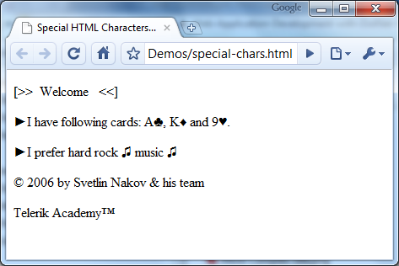
Special Chars – Example (2)
special-chars.html
<html>
<head>
<title>Special HTML Characters Example</title>
</head>
<body>
<p>[&gt;&gt;&nbsp;&nbsp;Welcome
&nbsp;&nbsp;&lt;&lt;]</p>
<p>&#9658;I have following cards:
A&#9827;, K&#9830; and 9&#9829;.</p>
<p>&#9658;I prefer hard rock &#9835;
music &#9835;</p>
<p>© 2006 by Svetlin Nakov &amp; his team</p>
<p>Telerik Academy™</p>
</body>
</html>

Slide 75
Block And Inline Elements
Block elements act as if there is a break before and after them
<div> is a block element
Other block elements are <table>, <hr>, headings, lists, <center>, <p> and etc.
Inline elements don’t break the text before and after them
<span> is inline element
Most HTML elements are inline, e.g. <a>

Slide 76
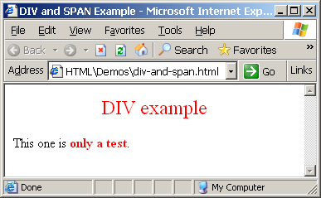
The <div> Tag
<div> creates logical divisions within a page
Block style element
Used with CSS
Example:
div-and-span.html
<div align="center" style="font-size:24; color:red">DIV example</div>
<p>This one is <span style="color:red; font-weight:bold">only a test</span>.</p>

Slide 77
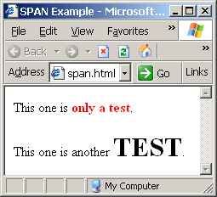
The <span> Tag
Inline style element
Useful for modifying a specific portion of text
Don't create a separate area (paragraph) in the document
Very useful with CSS
span.html
<p>This one is <span style="color:red; font-weight:bold">only a test</span>.</p>
<p>This one is another <span style="font-size:32; font-weight:bold">TEST</span>.</p>

Slide 78
HTML Tables

Slide 79
HTML Tables
Tables represent tabular data
A table consists of one or several rows
Each row has one or more columns
Tables comprised of several core tags: <table></table>: begin / end the table <tr></tr>: create a table row <td></td>: create tabular data (cell)
Tables are losing favor to <div> and <span>, with the CSS revolution

Slide 80
HTML Tables (2)
Start and end of a table
Start and end of a row
Start and end of a cell in a row
<table> ... </table>
<tr> ... </tr>
<td> ... </td>

Slide 81
Simple HTML Tables – Example
<table border="1" cellspacing="0" cellpadding="5">
<tr>
<td><img src="ppt.gif"></td>
<td><a href="lecture1.ppt">Lecture 1</a></td>
</tr>
<tr>
<td><img src="ppt.gif"></td>
<td><a href="lecture2.ppt">Lecture 2</a></td>
</tr>
<tr>
<td><img src="zip.gif"></td>
<td><a href="lecture2-demos.zip">
Lecture 2 - Demos</a></td>
</tr>
</table>

Slide 82
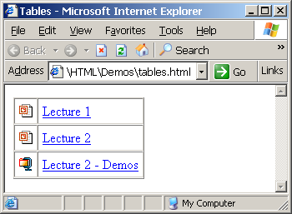
Simple HTML Tables – Example (2)
<table border="1" cellspacing="0" cellpadding="5">
<tr>
<td><img src="ppt.gif"></td>
<td><a href="lecture1.ppt">Lecture 1</a></td>
</tr>
<tr>
<td><img src="ppt.gif"></td>
<td><a href="lecture2.ppt">Lecture 2</a></td>
</tr>
<tr>
<td><img src="zip.gif"></td>
<td><a href="lecture2-demos.zip">
Lecture 2 - Demos</a></td>
</tr>
</table>

Slide 83
Complete HTML Tables
Tables rows split into three sections: heading, body and footer, each containing table rows
Divides the table into semantic sections
Table sections:
<thead> denotes table heading
<tbody> denotes collection of table rows that contain the very data
<tfoot> denotes table footer but comes BEFORE the <tbody> tag

Slide 84
Complete HTML Table: Example
First comes the header
<table>
<thead>
<tr><td>Column heading</td><td>Column
heading</td></tr>
</thead>
<tfoot>
<tr><td>Column footer</td><td>Column
footer</td></tr>
</tfoot>
<tbody>
<tr><td>Cell 1</td><td>Cell 2</td></tr>
<tr><td>Cell 3</td><td>Cell 4</td></tr>
</tbody>
</table>
Then comes the footer
Last comes the body (data)

Slide 85
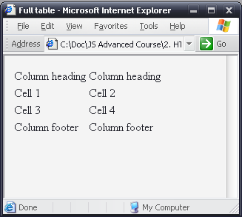
Complete HTML Table: Example
table-full.html
<table>
<thead>
<tr><td>Column heading</td><td>Column
heading</td></tr>
</thead>
<tfoot>
<tr><td>Column footer</td><td>Column
footer</td></tr>
</tfoot>
<tbody>
<tr><td>Cell 1</td><td>Cell 2</td></tr>
<tr><td>Cell 3</td><td>Cell 4</td></tr>
</tbody>
</table>
Although the footer is before the data in the code, it is displayed last

Slide 86
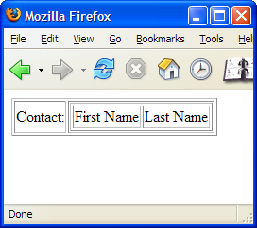
Nested Tables
Table data “cells” (<td>) can contain nested tables (tables within tables):
nested-tables.html
<table border="1">
<tr>
<td>Contact:</td>
<td>
<table border="1">
<tr>
<td>First Name</td>
<td>Last Name</td>
</tr>
</table>
</td>
</tr>
</table>

Slide 87
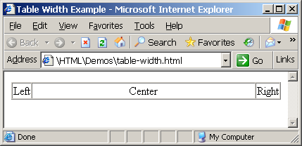
Cells Width
Tables and cells can have width attribute
Width can be given in pixels or percentages
table-width.html
<table border="1" width="100%" cellspacing="0">
<tr>
<td>Left</td>
<td width="100%" align="center">Center</td>
<td>Right</td>
</tr>
</table>

Slide 88
Cell Spacing and Padding
Tables have two important attributes:
cellspacing
Defines the empty space between the cells
cellpadding
Defines the empty space around the cell contents
cell
cell
cell
cell
cell
cell
cell
cell

Slide 89
Cell Spacing and Padding – Example
table-cells.html
<html>
<head><title>Table Cells</title></head>
<body>
<table cellspacing="15" cellpadding="0"
bgcolor="red">
<tr><td bgcolor="yellow">First</td>
<td bgcolor="yellow">Second</td></tr>
</table>
<br/>
<table cellspacing="0" cellpadding="10"
bgcolor="yellow" border="1">
<tr><td>First</td><td>Second</td></tr>
</table>
</body>
</html>

Slide 90
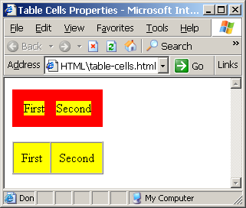
Cell Spacing and Padding – Example (2)
table-cells.html
<html>
<head><title>Table Cells</title></head>
<body>
<table cellspacing="15" cellpadding="0"
bgcolor="red">
<tr><td bgcolor="yellow">First</td>
<td bgcolor="yellow">Second</td></tr>
</table>
<br/>
<table cellspacing="0" cellpadding="10"
bgcolor="yellow" border="1">
<tr><td>First</td><td>Second</td></tr>
</table>
</body>
</html>

Slide 91
Column and Row Span
Table cells have two important attributes:
colspan
Defines how many columns the cell occupies
rowspan
Defines how many rows the cell occupies
colspan="1"
colspan="1"
rowspan="2"
rowspan="1"
cell[1,1]
cell[1,2]
cell[1,1]
cell[1,2]
cell[2,1]
cell[2,1]
colspan="2"
rowspan="1"

Slide 92
Column and Row Span – Example
table-colspan-rowspan.html
<html>
<head><title>Colspan and Rowspan</title></head>
<body>
<br/>
<table cellspacing="0" cellpadding="10"
border="1">
<tr bgcolor="yellow"><td>Cell[1,1]</td>
<td colspan="2">Cell[2,1]</td></tr>
<tr bgcolor="#FFCC66"><td>Cell[1,2]</td>
<td rowspan="2">Cell[2,2]</td>
<td>Cell[3,2]</td></tr>
<tr bgcolor="#CCCCFF"><td>Cell[1,3]</td>
<td>Cell[2,3]</td></tr>
</table>
</body>
</html>

Slide 93
Column and Row Span – Example (2)
table-colspan-rowspan.html
<html>
<head><title>Colspan and Rowspan</title></head>
<body>
<br/>
<table cellspacing="0" cellpadding="10"
border="1">
<tr bgcolor="yellow"><td>Cell[1,1]</td>
<td colspan="2">Cell[2,1]</td></tr>
<tr bgcolor="#FFCC66"><td>Cell[1,2]</td>
<td rowspan="2">Cell[2,2]</td>
<td>Cell[3,2]</td></tr>
<tr bgcolor="#CCCCFF"><td>Cell[1,3]</td>
<td>Cell[2,3]</td></tr>
</table>
</body>
</html>
Cell[1,1]
Cell[2,1]
Cell[1,2]
Cell[2,2]
Cell[3,2]
Cell[1,3]
Cell[2,3]

Slide 94
HTML Forms
Entering User Data from a Web Page

Slide 95
HTML Forms
Forms are the primary method for gathering data from site visitors
Create a form block with
Example:
The “method" attribute tells how the form data should be sent – via GET or POST request
<form></form>
<form name="myForm" method="post" action="path/to/some-script.php">
...
</form>
The "action" attribute tells where the form data should be sent

Slide 96
Form Fields
Text fields are single-line entry fields:
Text areas can contain multiple lines of text:
Hidden fields contain data not shown to user:
Often used by JavaScript code
<input type="text" name="FirstName" value="This is a text field">
<textarea name="Comments">This is a multi-line text field</textarea>
<input type="hidden" name="Account" value="This is a hidden text field">

Slide 97
Form Input Controls
Create a checkbox:
Create a radio button:
Radio buttons can be grouped, allowing only one to be selected from a group:
<input type="checkbox" name="fruit" value="apple">
<input type="radio" name="title" value="Mr.">
<input type="radio" name="town" value="Sofia">
<input type="radio" name="town" value="Varna">

Slide 98
Other Form Controls
Pull down menu (drop-down list):
Submit button:
<select name="gender">
<option value="Value 1"
selected="selected">Male</option>
<option value="Value 2">Female</option>
<option value="Value 3">Other</option>
</select>
<input type="submit" name="submitBtn" value="Apply Now">

Slide 99
Other Form Controls (2)
Reset button – clears the form
Image button – acts like submit but image is displayed instead of button
Ordinary button – used for JavaScript, no default action
<input type="reset" name="resetBtn" value="Clear the form">
<input type="image" src="submit.gif" name="submitBtn" alt="Submit">
<input type="button" value="simple button">

Slide 100
Other Form Controls (3)
Password input – acts like normal text field but hides the text with * signs
Multiple select field – code is like drop down but displays list of items to select
<input type="password" name="pass" value="">
<select name="products" multiple="multiple">
<option value="Value 1"
selected="selected">keyboard</option>
<option value="Value 2">mouse</option>
<option value="Value 3">speakers</option>
</select>

Slide 101
HTML Forms – Example
form.html
<form method="POST" action="apply-now.php">
<input name="subject" type="hidden" value="Class" />
<p>Degree:
<select name="degree">
<option value="BA">Bachelor of Art</option>
<option value="BS">Bachelor of Science</option>
<option value="MBA" selected="true">Master of
Business Administration</option>
</select>
</p>
<p>
First Name: <input type="text" name="firstname" />
</p>
<p>
Last Name: <input type="text" name="lastname" />
</p>
<p>
Student ID: <input type="password" name="studentid" />
</p>

Slide 102
HTML Forms – Example (2)
form.html (continuation)
<p>
Gender:
<input name="gender" type="radio" value="Male"
checked="true" /> Male
<input name="gender" type="radio" value="Female" />
Female
</p>
<p>
E-mail: <input type="text" name="email" value="" />
</p>
<p>
<textarea name="terms" cols="30" rows="4"
readonly="true">TERMS AND CONDITIONS
By clicking the Send Form button you agree to submit this form.</textarea>
</p>
<p>
<input type="submit" name="button" value="Send Form" />
</p>
</form>

Slide 103
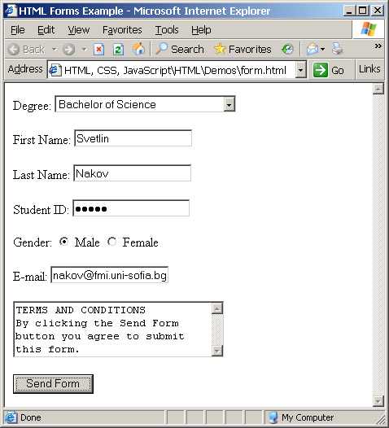
HTML Forms – Example (3)
form.html (continuation)
<p>
Gender:
<input name="gender" type="radio" value="Male"
checked="true" /> Male
<input name="gender" type="radio" value="Female" />
Female
</p>
<p>
E-mail: <input type="text" name="email" value="" />
</p>
<p>
<textarea name="terms" cols="30" rows="4"
readonly="true">TERMS AND CONDITIONS
By clicking the Send Form button you agree to submit this form.</textarea>
</p>
<p>
<input type="submit" name="button" value="Send Form" />
</p>
</form>

Slide 104
CSS
Styling with Cascading Stylesheets
Very Quick Introduction

Slide 105
CSS Introduction
Cascading Style Sheets (CSS)
Markup language, used to describe the presentation of document
Defines sizes, fonts, colors, layout, etc.
Improves content accessibility
Improves flexibility
Designed to separate presentation from content
Because of CSS all HTML presentation tags are deprecated, e.g. <font> <center> <b> etc.

Slide 106
Style Sheets Syntax
Simple syntax, based on English words
Contains of set of cascading rules
Rule consists of one or more selectors and declaration block
Declaration block consists of one or more semicolon-terminated declarations in curly braces
Declaration consists of property, a colon and value
h1,h2,h3,h4,h5,h6 { color: green }

Slide 107
Style Sheets Syntax (2)
Selectors determine which element the rule applies to:
All elements of specific type
Those that mach specific attribute
Elements may be matched depending on how they are nested in the document (HTML)

Slide 108
Style Sheets Syntax (3)
Pseudo-classes define further behavior
Appended to a selector
Examples: :hover, :first-letter, :visited, :before, :after
Not all browser support them well

Slide 109
Style Sheets Syntax (4)
Three primary types of selectors:
By tag:
By element id:
By element class name (only for HTML):
Selectors can be combined with commas:
will match <h1> tags, elements with class link and element with id top-link
h1 {font-face: Verdana}
#element_id {color:#FF0000}
.class_name {border: 1px solid red}
h1, .link, #top-link {font-weight: bold}

Slide 110
Style Sheets Syntax (5)
Match elements, relative to their placement in document:
will match all <a> tags that are descendants of <p> tag (may not be direct child!)
* - universal selector:
will match all child nodes of <p> tag
+ selector – used to match “following” tag:
will match all elements with class name link that appear immediately after <img> tag
p a {text-decoration: underline}
p * {color: black}
img + .link {float:right}

Slide 111
Inline Styles
Inline styles
Individual element’s style defined using style attribute
Contains only declaration, no selectors:
Override any other styles
Apply to all descendant elements
Used for styles that are not needed anywhere else on site
<p style = "font-size: 20 pt; color: #0000FF">

Slide 112
Inline Styles: Example
inline-styles.html
<!DOCTYPE html PUBLIC "-//W3C//DTD XHTML 1.0 Transitional//EN" "http://www.w3.org/TR/xhtml1/DTD/xhtml1-transitional.dtd">
<html xmlns="http://www.w3.org/1999/xhtml"
lang="en" xml:lang="en">
<head>
<title>Inline Styles</title>
</head>
<body>
<p>Here is some text</p>
<!--Separate multiple styles with a semicolon-->
<p style="font-size: 20pt">Here is some
more text</p>
<p style="font-size: 20pt;color:
#0000FF" >Even more text</p>
</body>
</html>

Slide 113
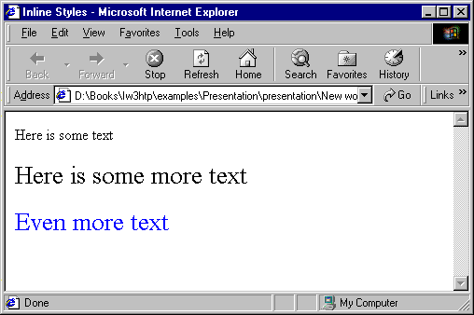
Inline Styles: Example (2)
inline-styles.html
<!DOCTYPE html PUBLIC "-//W3C//DTD XHTML 1.0 Transitional//EN" "http://www.w3.org/TR/xhtml1/DTD/xhtml1-transitional.dtd">
<html xmlns="http://www.w3.org/1999/xhtml"
lang="en" xml:lang="en">
<head>
<title>Inline Styles</title>
</head>
<body>
<p>Here is some text</p>
<!--Separate multiple styles with a semicolon-->
<p style="font-size: 20pt">Here is some
more text</p>
<p style="font-size: 20pt;color:
#0000FF" >Even more text</p>
</body>
</html>

Slide 114
Embedded Styles
Embedded in the html in <style> tag:
Apply to the whole document
type attribute specifies the MIME type
MIME is a standard for specifying the format of content
Other MIME types include text/html, image/gif and text/javascript
The <style> tag is placed in the <head> section of the document
Used for document-specific style
<style type="text/css">

Slide 115
Embedded Styles: Example
embedded-stylesheets.html
<!DOCTYPE html PUBLIC "-//W3C//DTD XHTML 1.0 Transitional//EN" "http://www.w3.org/TR/xhtml1/DTD/xhtml1-transitional.dtd">
<html xmlns="http://www.w3.org/1999/xhtml"
lang="en" xml:lang="en">
<head>
<title>Style Sheets</title>
<style type="text/css">
em {background-color: #8000FF;color: white}
h1 {font-family: Arial, sans-serif }
p {font-size: 18pt}
.blue {color: blue}
</style>
<head>

Slide 116
Embedded Styles: Example (2)
…
<body>
<h1 class="blue">A Heading</h1>
<p>Here is some text. Here is some text. Here
is some text. Here is some text. Here is some
text.</p>
<h1>Another Heading</h1>
<p class="blue">Here is some more text.
Here is some more text.</p>
<p class="blue">Here is some <em>more</em>
text. Here is some more text.</p>
</body>
</html>

Slide 117
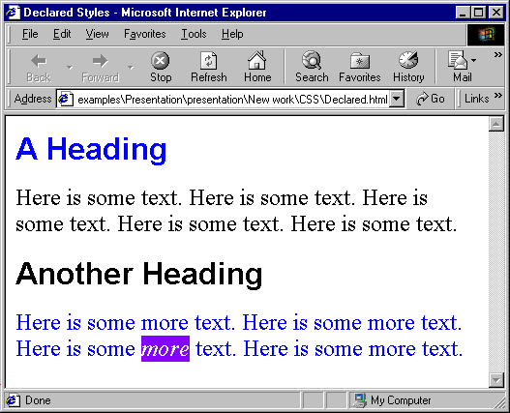
Embedded Styles: Example (3)
…
<body>
<h1 class="blue">A Heading</h1>
<p>Here is some text. Here is some text. Here
is some text. Here is some text. Here is some
text.</p>
<h1>Another Heading</h1>
<p class="blue">Here is some more text.
Here is some more text.</p>
<p class="blue">Here is some <em>more</em>
text. Here is some more text.</p>
</body>
</html>

Slide 118
External CSS Styles
External linking
Separate pages can all use same style sheet
Only modify a single file to change styles across your site
link tag (with rel attribute)
Specifies a relationship between current document and another document
link element can only be in the header
<link rel="stylesheet" type="text/css"
href="styles.css">

Slide 119
External Styles: Example
styles.css
/* CSS Document */
a { text-decoration: none }
a:hover { text-decoration: underline;
color: red;
background-color: #CCFFCC }
li em { color: red;
font-weight: bold }
ul { margin-left: 2cm }
ul ul { text-decoration: underline;
margin-left: .5cm }

Slide 120
External Styles: Example (2)
external-styles.html
<!DOCTYPE html PUBLIC "-//W3C//DTD XHTML 1.0
Transitional//EN"
"http://www.w3.org/TR/xhtml1/DTD/xhtml1-transitional.dtd">
<html xmlns="http://www.w3.org/1999/xhtml"
xml:lang="en" lang="en">
<head>
<title>Importing style sheets</title>
<link type="text/css" rel="stylesheet"
href="styles.css" />
</head>
<body>
<h1>Shopping list for <em>Monday</em>:</h1>
<li>Milk</li>
…

Slide 121
External Styles: Example (3)
…
<li>Bread
<ul>
<li>White bread</li>
<li>Rye bread</li>
<li>Whole wheat bread</li>
</ul>
</li>
<li>Rice</li>
<li>Potatoes</li>
<li>Pizza <em>with mushrooms</em></li>
</ul>
<a href="http://food.com" title="grocery
store">Go to the Grocery store</a>
</body>
</html>

Slide 122
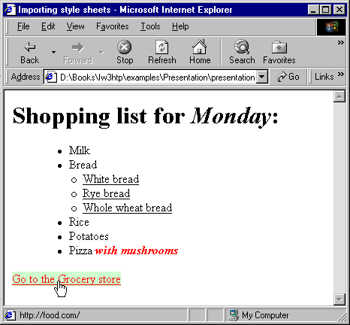
External Styles: Example (4)
…
<li>Bread
<ul>
<li>White bread</li>
<li>Rye bread</li>
<li>Whole wheat bread</li>
</ul>
</li>
<li>Rice</li>
<li>Potatoes</li>
<li>Pizza <em>with mushrooms</em></li>
</ul>
<a href="http://food.com" title="grocery
store">Go to the Grocery store</a>
</body>
</html>

Slide 123
Web Technologies Basics
?
?
?
?
?
Questions?
?
?
?
?
?
http://academy.telerik.com

